Slide 1
Chapter 2
Building a Webpage Template with HTML 5

Slide 2
Objectives
You will have mastered the material in this chapter when you can:
Explain how to manage website files
Describe and use HTML 5 semantic elements
Determine the elements to use when setting the structure of a webpage
Design and build a semantic wireframe
Create a webpage template
Insert comments in an HTML document
Add static content to a webpage template

Slide 3
Objectives (continued)
Insert symbol codes and other character entities
Describe and use heading elements
Describe the benefits of validating web documents
Validate an HTML template
Create a home page from an HTML template
Add unique content to a webpage

Slide 4
Introduction
Building a website from scratch involves a lot of time and planning
Professional web design services are in high demand
Before building a website, plan it
Includes meeting with clients or stakeholders to discover needs, the purpose of the website, and target audience

Slide 5
Project — Plan and Build a Website
The project in this chapter follows generally accepted guidelines for planning and building a webpage template and homepage
Roadmap
CREATE WEBSITE FOLDERS to organize files
CREATE a TEMPLATE
ENTER HTML 5 SEMANTIC ELEMENTS in the document
ADD COMMENTS AND CONTENT to the document
VALIDATE the DOCUMENT
CREATE AND VIEW the HOME PAGE

Slide 6
Designing a Website
Activities involved in designing a website
Planning
Articulating the website’s purpose
Identifying the target audience
Creating a site map and wireframe
Selecting graphics and colors to use in the site
Determining whether to design for an optimal viewing experience across a range of devices

Slide 7
Designing a Website (continued)
Purpose of the Website | To promote fitness services and gain new clients. The Forward Fitness Club mission: facilitate a healthy lifestyle and help our clients meet their fitness and nutrition goals.
Target Audience | Forward Fitness Club customers are adults between the ages of 18 and 50 within the local community.
Multiplatform Display | Forward Fitness Club recognizes the growth in smartphone and tablet usage and wants a single website that provides an optimal viewing experience regardless of whether visitors are using a desktop, laptop, tablet, or smartphone.
Wireframe and Site Map | The initial website will consist of five webpages arranged in a hierarchal structure with links to the home page on every page. Each webpage will include a header area, navigation area, main content area, and footer area.
Graphics | Forward Fitness Club wants to display its fitness equipment and logo to help with local branding. Photos of the facility, members, and staff will increase visual appeal.
Color | Forward Fitness Club wants to use black and white as the primary colors for a clean, sophisticated look.
Typography | To make the content easy to read, the website will use a serif font style for paragraphs, lists, and other body content, while providing contrast by using a sans serif font style for navigation links and headings.
Accessibility | Standard accessibility attributes, such as alternative text for graphics, will be used to address accessibility.
Table 2–1 Forward Fitness Club Website Plan

Slide 8
Site Map
Indicates how the pages in a website relate to each other
Example: Forward Fitness Club website
Home page: Introduces the fitness center and its mission statement
About Us page: Showcases the facility’s equipment and services
Classes page: Includes a schedule of available group training and fitness classes
Nutrition page: Provides nutrition tips and simple meal plans
Contact Us page: Provides a phone number, email address, physical address, and form for potential clients to request additional information about the fitness center’s services

Slide 9
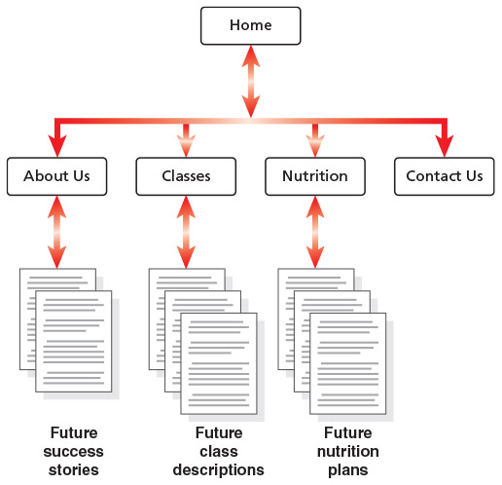
Site Map (continued)
Figure 2–2

Slide 10
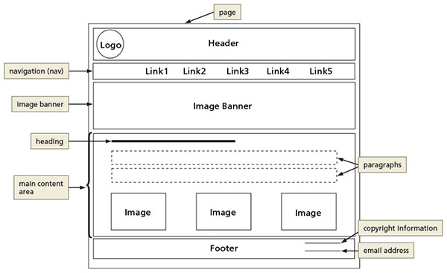
Wireframe
Wireframe depicts the layout of a webpage, including its major content areas
Figure 2–3

Slide 11
File Management
Websites use several types of files
HTML files, image files, media such as audio and video files, and CSS files
Each site must follow a systematic method to organize its files
The main folder, also called the root folder, contains all files and other folders for the website

Slide 12
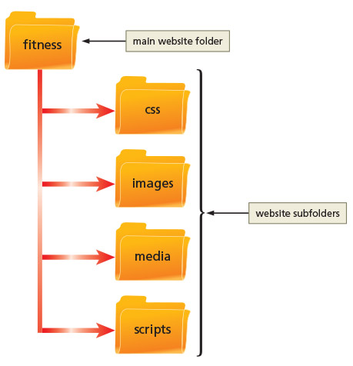
File Management (continued 1)
Figure 2–4

Slide 13
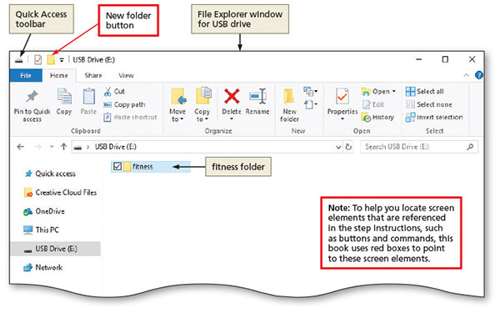
File Management (continued 2)
Create a website folder and subfolders
Figure 2–5

Slide 14
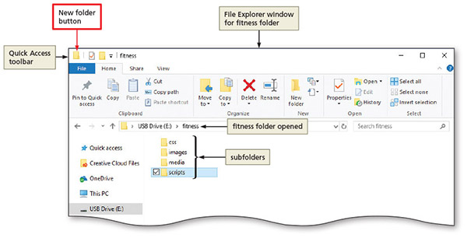
File Management (continued 3)
Figure 2–6

Slide 15
Using HTML 5 Semantic Elements
Begin a new HTML document by adding the basic required HTML elements
DOCTYPE, html, head, and body elements
HTML 5 introduced several new semantic elements with standardized names
Name of each tag reflects the purpose
Header
Nav
Main
Footer

Slide 16
Using HTML 5 Semantic Elements (continued 1)
Element | Description
<header>…</header> | Indicates the header information on the webpage. Header content typically consists of a business name or logo and is commonly positioned immediately after the opening <body> tag.
<nav>…</nav> | Indicates the start and end of a navigation area within the webpage. The nav element contains hyperlinks to other webpages within a website and is commonly positioned immediately after the closing </header> tag.
<main>…</main> | Indicates the start and end of the main content area of a webpage. Contains the primary content of the webpage. Only one main element can appear on a page.
<footer>…</footer> | Indicates the start and end of the footer area of a webpage. Contains the footer content of the webpage.
<section>…</section> | Indicates the start and end of a section area of a webpage. Contains a specific grouping of content on the webpage.
<article>…</article> | Indicates the start and end of an article area of a webpage. Contains content such as forum or blog posts.
<aside>…</aside> | Indicates the start and end of an aside area of a webpage. Contains information about nearby content and is typically displayed as a sidebar.
Table 2-2

Slide 17
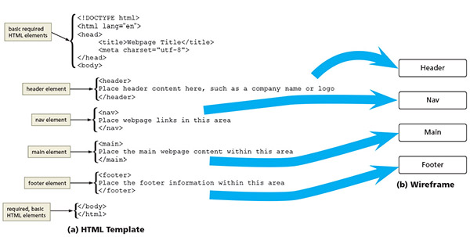
Using HTML 5 Semantic Elements (continued 2)
Figure 2–7

Slide 18
Creating a Webpage Template
A hallmark of a well-designed website is that its webpages have the same look and feel
Pages have the same layout, color scheme, typography, and style of graphics
Elements work the same way on each page
Templates are used to make sure webpages in a site share a standard layout
HTML document containing elements that should appear on each page
Instead of creating a webpage from scratch, open the template document in a text editor and save it using the name of the new webpage

Slide 19
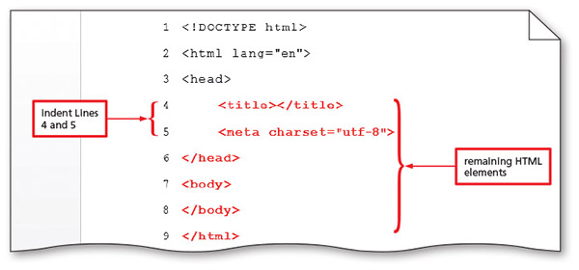
Creating a Webpage Template (continued 1)
Create a webpage template
An HTML document with the HTML elements that define the webpage structure
Figure 2–10

Slide 20
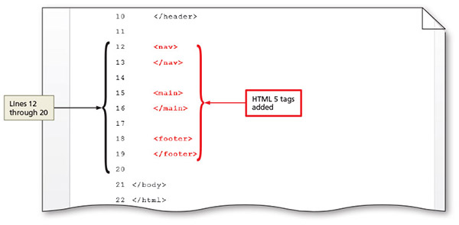
Creating a Webpage Template (continued 2)
Add HTML 5 semantic elements to a webpage template
Define content areas
Figure 2–12

Slide 21
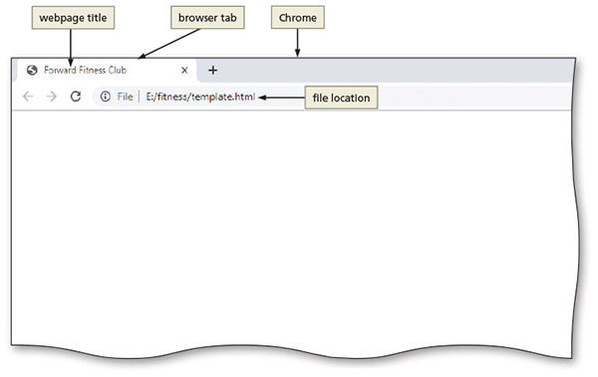
Creating a Webpage Template (continued 3)
Add a title to a webpage template
Figure 2–13

Slide 22
Comments
Comments can provide additional information about the areas within the webpage
Add a comment before a tag using the following tag:
<! - - Place your comment here - - >
Word wrap causes text lines to break at the right edge of the window and appear on a new line
All entered text is visible in the Notepad++ window

Slide 23
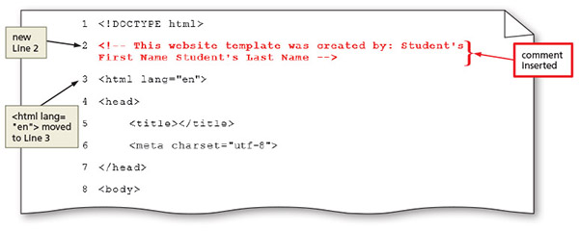
Comments (continued 1)
Add comments to a webpage template
Figure 2–14

Slide 24
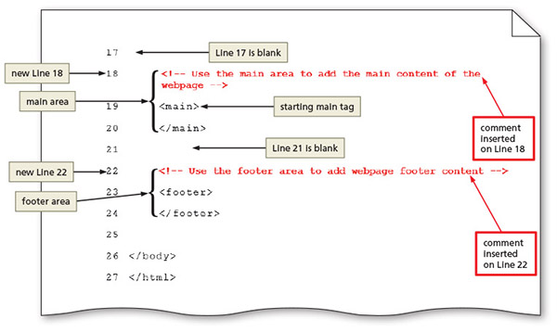
Comments (continued 2)
Figure 2–17

Slide 25
Heading Elements
Heading elements provide a title or heading before a paragraph of text or section of a page
Indicate that a new topic is starting and typically identify or summarize the topic
Appear in a larger font size than normal text
Make it easy for users to quickly scan the page and identify its sections

Slide 26
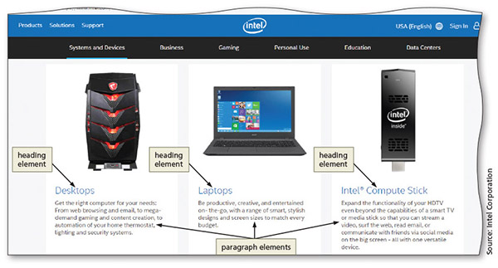
Heading Elements (continued 1)
Figure 2–18

Slide 27
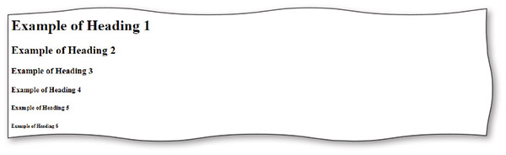
Heading Elements (continued 2)
Figure 2–19

Slide 28
Webpage Content
Static content that will appear on every webpage can be added to a webpage
Business name or logo, the webpage links, and the footer information
Example of content added between header tags:
<header> <h1>Forward Fitness Club </h1>
</header>

Slide 29
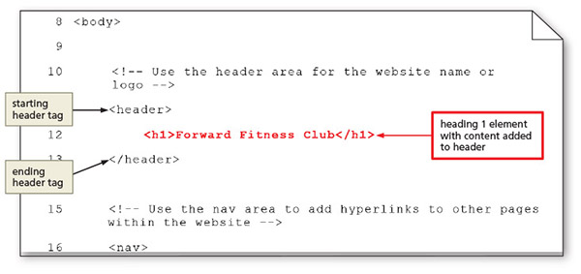
Webpage Content (continued)
Add content to the header section
Figure 2–20

Slide 30
Using Symbol Entities
A symbol can be added to an HTML webpage by typing its HTML entity name or entity number
Inserting an HTML character entity in the code displays a reserved HTML character on the webpage
Entity name is an abbreviated name
Entity number is a combination of the pound sign (#) and a numeric code

Slide 31
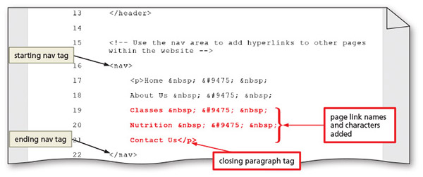
Using Symbol Entities (continued 1)
Add text and nonbreaking spaces to the nav section
Figure 2–23

Slide 32
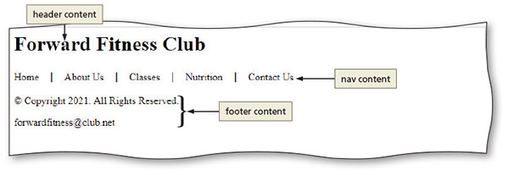
Using Symbol Entities (continued 2)
Add content and a symbol to the footer section
Figure 2–25

Slide 33
Using Symbol Entities (continued 3)
Character | Description | Entity Name | Entity Number
© | Copyright symbol | &copy; | &#169;
® | Registered trademark | &reg; | &#174;
€ | Euro | &euro; | &#8364;
& | Ampersand | &amp; | &#38;
< | Less than | &lt; | &#60;
> | Greater than | &gt; | &#62;
 | Nonbreaking space | &nbsp; | &#160;
Table 2–3 Common Symbol Entities

Slide 34
Validating HTML Documents
After creation of an HTML file, the document is validated to verify HTML code validity
Validator checks for errors, indicates where they are located, and suggests corrections
If the validator detects an error in an HTML code, it displays a warning in the header bar
Result line below the header bar shows the number of errors in the document

Slide 35
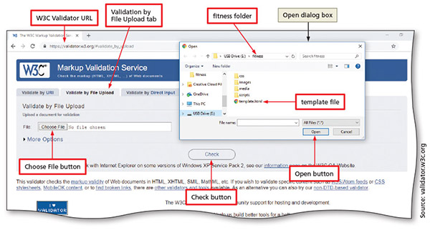
Validating HTML Documents (continued 1)
Validate the webpage template
Figure 2–26

Slide 36
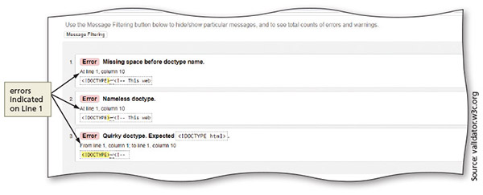
Validating HTML Documents (continued 2)
Validate an HTML document with errors
Figure 2–29

Slide 37
Creating a Home Page Using a Webpage Template
After creating a template for a website, you can save time by using the template to create the webpages in the site
The advantage of starting with a template is that it includes content and HTML elements that appear on every page

Slide 38
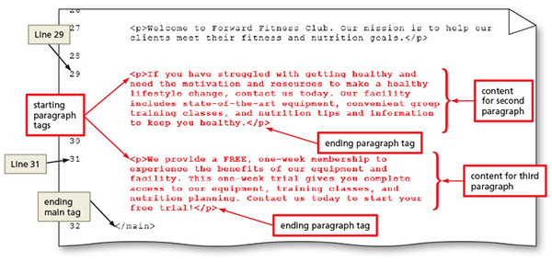
Creating a Home Page Using a Webpage Template (continued 1)
Create a home page using a webpage template and add content
Figure 2–31

Slide 39
Creating a Home Page Using a Webpage Template (continued 2)
Display a home page in the default browser
Figure 2–32

Slide 40
Chapter Summary
In this chapter, you learned about:
Preparing a website by organizing folders for the webpage files
Using HTML 5 structural elements to create a webpage template
Validating the template
Creating the home page

